Slide 1
Multithreading
Muhammad Saeed
saeed@uok.edu.pk

Slide 2
Topics
Multitasking vs Multithreading
Process
Threads
Why Threading
Shared Memory & Thread Safe
Threads
Start
Join
Sleep
Passing Arguments

Slide 3
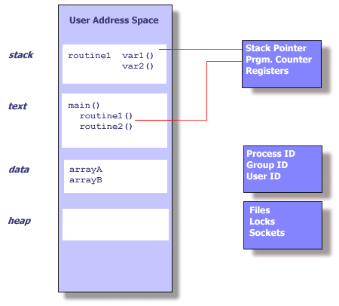
Process

Slide 4
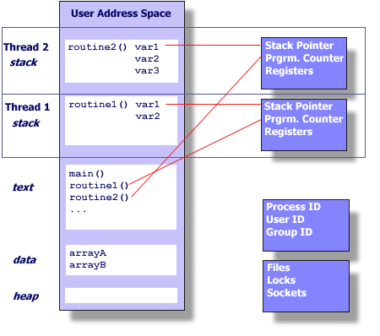
Thread

Slide 5
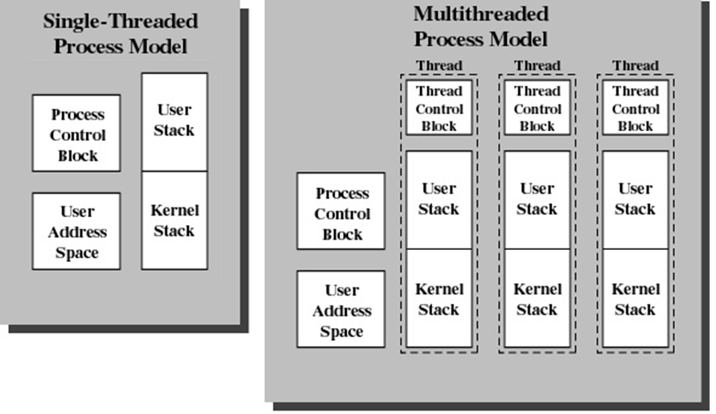
Multitasking vs Multithreading

Slide 6
Why Threading
Multitasking
fork() in UNIX/LINUX
Problems
Time to create new process
Memory requirements
Switching Time for scheduling
Solution
Multithreading
pthread_create() in UNIX/LINUX

Slide 7
Benefits of Threads
Less time to
create a new thread than a process
terminate a thread than a process
switch between two threads within the same process
Since threads within the same process share memory and files, they can communicate with each other without invoking the Operating System kernel

Slide 8
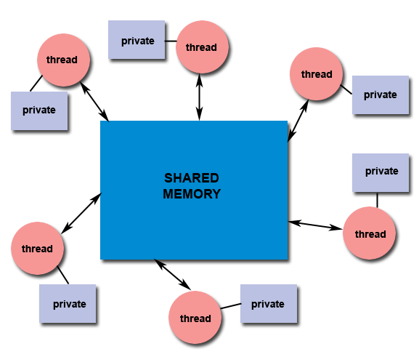
Shared Memory
All threads have access to the same global, shared memory
Threads also have their own private data
Programmers are responsible for synchronizing access (protecting) globally shared data.

Slide 9
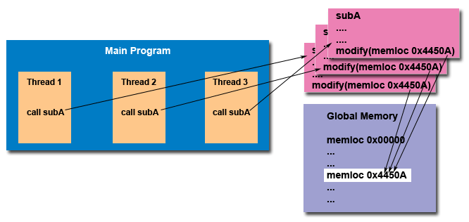
“Thread Safe”

Slide 10
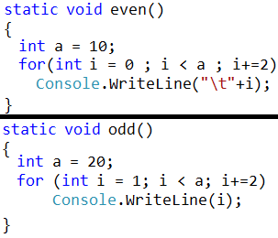
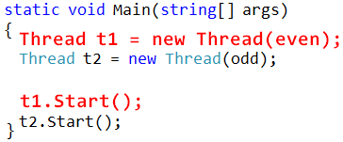
Thread → Start

Slide 11
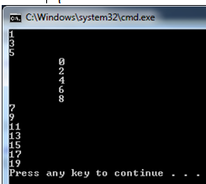
Output

Slide 12
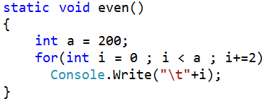
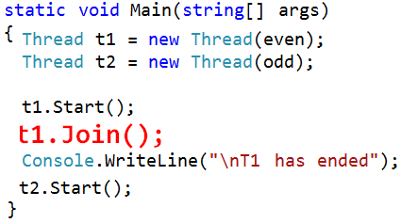
Thread → Join

Slide 13
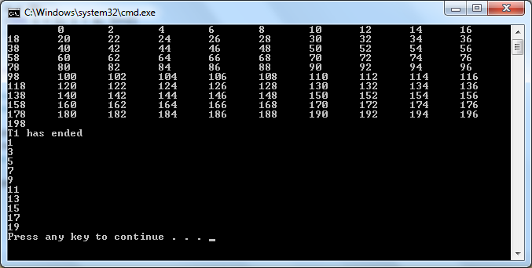
Output

Slide 14
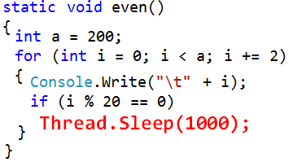
Thread → Sleep

Slide 15
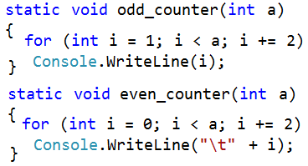
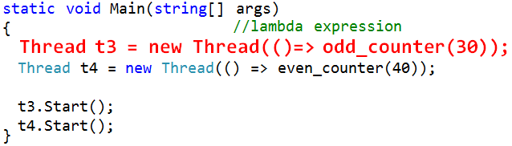
Thread → Passing Argument

Slide 16
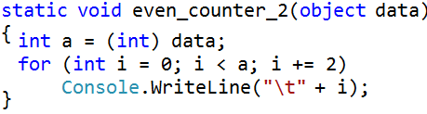
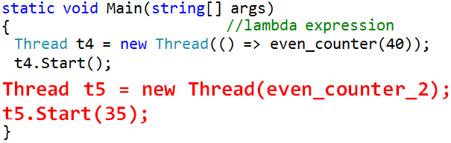
Thread → Passing Argument

Slide 17
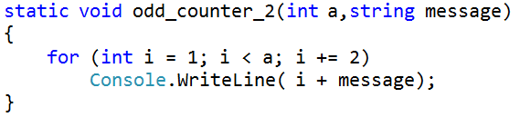
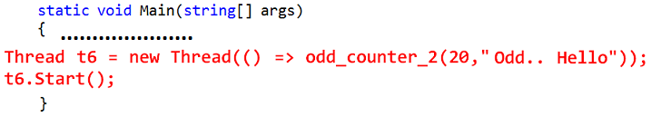
Thread → Passing Multiple Arguments

Slide 18
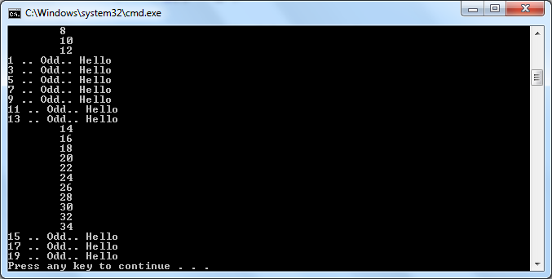
Output

